Slide 1
Python Part V: Object Oriented Programming
Class Definitions
Data Members & Methods
Class vs. Instance Variables, Static Methods
Inheritance
Multiple Inheritance & The Diamond Problem
The super() Method
Iterators & Generators

Slide 2
Object Oriented Programming
All methods and data members of an object are public
All methods are virtual (C++ terminology)
It is customary to call class members as attributes
methods are class functions, functions are global
Inside a class definition, a new namespace is created
All local variables assignment and functions (methods) definitions bind to this namespace
After the class definition terminates, the original local scope is returned and a class object is created
Not to be confused with an instance of the class!
The attributes and methods can be accessed with the class name prefix, without creating an instance
Notes:
תזכורת מתודות וירטואליות הן כאלו שעבורן בזמן ריצה יימצא המימוש המדוייק ביותר, כלומר אם בשרשרת הורשה יש לכולם אותה מתודה אז המפרש ימצא את המימוש עבור האובייקט שטיפוסו ידוע בזמן הריצה.

Slide 3
Class Definition
In Python, variables declared in the class definition are class variables, not instance variables (members)
Members declared in:
the (optional) constructor called __init__()
All other methods of the class
Outside the class definition by referencing an instance
The current object is called self (like this in C++)
Every method is declared with the first argument as self
In calls to methods we skip this argument
We cannot reference data attributes (or members) inside methods without the self prefix (i.e, self.member)
(Or the Class name prefix)
Notes:
The difference between static and not static method is if its first argument is “self”.
In newer versions of pycharm we need to add: @staticmethd above the def block

Slide 4
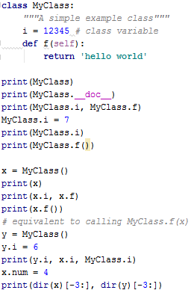

Basic Class Sample
What will be printed here if we added i=3 at the end of f()’s definition?
Notes:
ההדפסה תישאר זהה! מאחר וללא הקידומת של : self או שם המחלקה המשתנה i הינו לוקאלי!!! במתודה f(…)

Slide 5
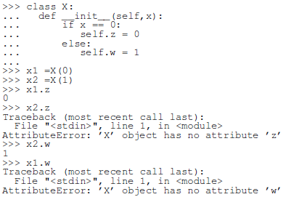
Notes on Class Attributes
We’ve seen that we can add members outside the class
We can also add methods
We can also define different members in __init__() →
All of those are radically different from C++/Java
To avoid confusion, one must carefully think before adding members/methods (possibly overriding existing members/methods) and changing the values of data members (since they are public)
It is advised to stick to coding conventions, like: Capitalized first word letters for methods (CalcGrade) and
meaningful names, verbs in methods vs. nouns in members, etc.

Slide 6
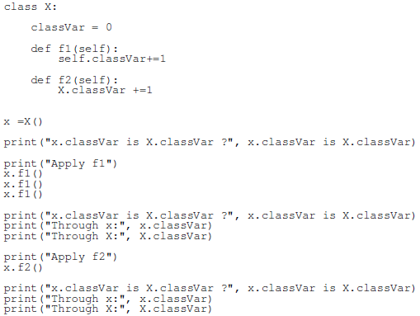
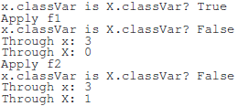
Class & Instance Variables
Explanation:
At start, x.classVar points to the value of the class variable (X.classVar). When we assign (+=) it a value, it points to a new value, so after the call to f1(), the two variables point to different values.

Slide 7
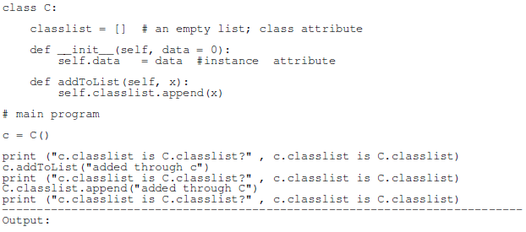


Mutable Class & Instance Variables
This is like the following →
If we used self.classlist = [x] instead of append, it would have pointed to a different list.

Slide 8
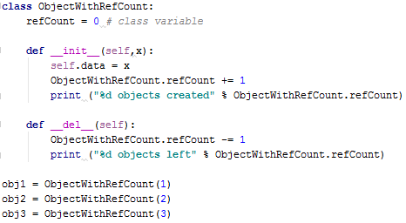
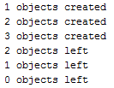
Reference Counting & Destructors
Class variables are similar to static variables in C++
We can use class variables for reference counting
Destructors are defined by __del__()
Output:
Notes:
סדר ההריסה אקראי!

Slide 9

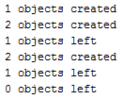
Reference Counting & Destructors
What would be the output of the following code:
Notes:
נשים לב שישנה הפנייה לאותו אובייקט בכל פעם.
כאשר האובייקט מקבל הפנייה חדשה, ההפנייה הקודמת מושמדת כלומר נכנסת ל- __del__ שלה בהתאמה

Slide 10
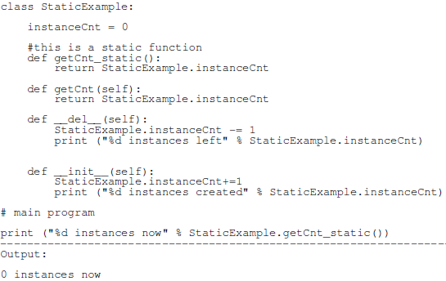

Static Methods
We can define static methods by omitting the self argument
Static methods cannot be called via instances x.getCnt_static()
Creating an instance in order to avoid using the static method has a different effect

Slide 11
Inheritance
Derived class definition: class Derived(Base)
class Derived(modulename.Base) is also valid
Attributes lookup (both data & methods) of derived classes instances go up the chain of inheritance
Python inheritance supports method overriding
When extending a method instead of overriding it, we can use Base.methodname(self, arguments)
issubclass(derived,base) checks inheritance
isinstance(object,type) returns true if object is of type type or derived from type

Slide 12
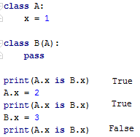
Class Variables and Inheritance
Class variables are inherited to derived classes
The base and derived class variables are same until the derived class variable assigned a new value
Similar to the way instance variables change from class variables when given a new value

Slide 13
Classes Exercise
Define a class called Shape that gets a length in its constructor. The class will have the following methods: __str__(), __lt__() and CalcArea().
__str__() should return a string with all the shape’s properties.
This allows us to call print() on a Shape object.
Define 3 derived classes to Shape: Square, Rectangle and Circle. Decide whether or not they need to receive more arguments in their constructors.
You should also decide which methods are implemented at Shape, which at its sons, and which should be overridden.
Each shape should print its unique properties including its area in a readable way.
The comparison between shapes should be based on the area using the CalcArea() and __lt__() method.
Shape should also include a class variable called shapes, which is a list that holds all the existing shapes, and a static function called PrintShapes() that prints all the shapes.

Slide 14
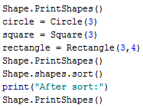
Classes Exercise: __main__
This should be the __main__ part of your program:

Slide 15
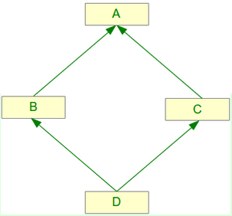
Multiple Inheritance
A class can inherit from multiple parents
class DerivedClassName(Base1, Base2, Base3)
Attributes lookup is done left-to-right, breadth-first
First look at Base1, then at Base2, then at Base3, then at Base1’s parents, Base2’s parents, and so on
This is known as Method Resolution Order (MRO)
In case of collisions, the first occurrence according to the lookup prevails
We will examine the diamond problem

Slide 16
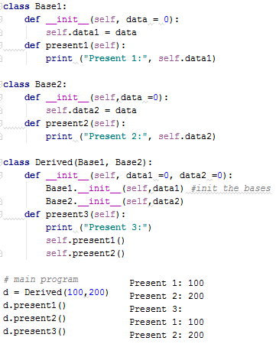
Multiple Inheritance Sample
Suppose Base1 and Base2 had both a member named data. What would be the output of print (d.data)?
Suppose Base1 and Base2 had both a method named present(). What would be the output of d.present()?
And if we changed the order of inheritance to Derived(Base2,Base1)?
200
100
200

Slide 17
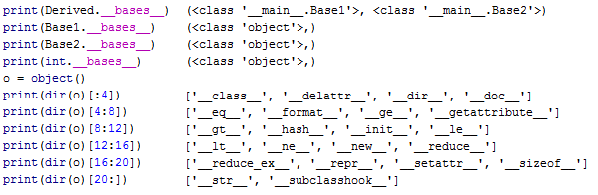
Object Class in Python
__bases__ return all of a derived class’ bases
All classes derive from class object
Now it is clear where all the __<attr>__ came from

Slide 18
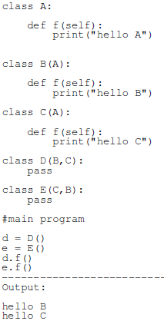
The Diamond Problem
Suppose class B(A) was defined by pass, and we called d.f() MRO
In this case Python will not find a definition for f() in B
Where will Python continue its search? C? A?
Since the search is BFS then C
If he don’t find anything in C he will continue to B’s parents i.e. A
(with s possibility to continue to
class object and stop there)

Slide 19
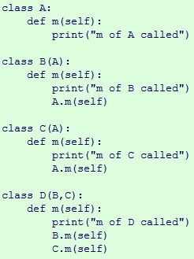
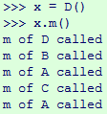
The Diamond Problem – Duplicate Method Calls
A prints something in method m
B & C extend m by printing something extra
We want D to print what A,B,C prints + something extra
What’s the problem here?
A’s m method will be called
twice ,once by B and once by C

Slide 20
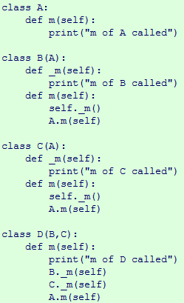
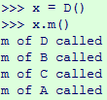
Avoiding Duplicate Method Calls-sol 1
One way to avoid duplicate methods calls is to split the method in subclasses
Splitting methods works – but this is the “non-Pythonic” way
Can be shortened to:
B._m(self)
C.m(self)

Slide 21
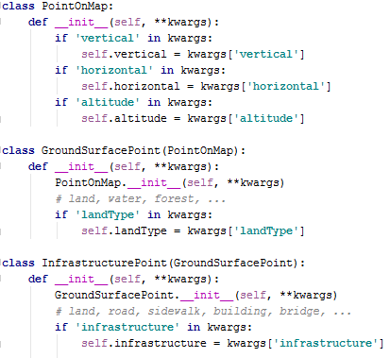
The super() Method – sol 2
Suppose we have a hierarchy of points for geographical layers
We want to add another layer between GroundSurfacePoint & InfrastructurePoint
We’ll have to change __init__ on InfrastructurePoint

Slide 22
The super() Method (2)
For this, we can use super() which returns a proxy object that delegates method calls to a parent class
super().__init__() instead of GroundSurfacePoint.__init__()
In a class hierarchy, super() can be used to refer to parent classes without naming them explicitly
This makes the code more maintainable
super() also supports cooperative multiple inheritance that automatically overcomes the diamond problem
This use case is unique to Python and is not found in statically compiled languages

Slide 23
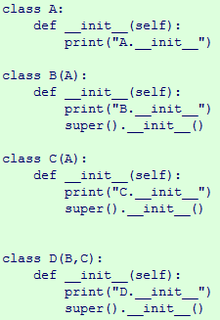

The super() Method (3)
Suppose we want something to be done upon object creation, without duplicates
This code produces:
Why isn’t A.__init__ printed twice?
super() calls follow the caller’s MRO and avoids duplicate calls
Thus it is D→B→C→A
We can check a class’ MRO using mro()

Slide 24
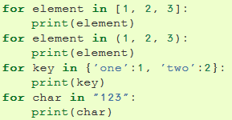
Iterators
By now we’ve seen several ways to iterate sequences:
What happens behind
the scenes?
The for statement calls iter() on the container object
iter() returns an iterator object that defines __next__()
__next__() accesses the container elements one by one
When __next__() finishes it raises a StopIteration exception, which tells the for loop to terminate
Calling next(iter) is equivalent to iter.__next__()
Notes:
הערה קטנה: אין צורך לתפוס את החריגה , הלולאה עושה זאת בשבילנו! אפשר לומר שזאת חריגה מיוחדת עבור ריצה בלולאות על מבני נתונים שונים.
מה שכן עלינו להקפיד לזרוק חריגה זו בשלב כלשהו בלוגיקה של האיטרטור שאנחנו כותבים במתודה __next__() .

Slide 25
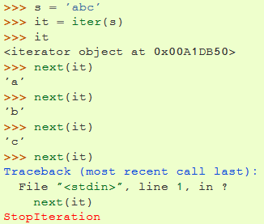
String Iterator Example

Slide 26
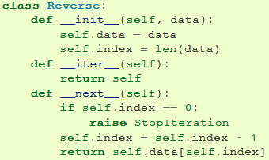
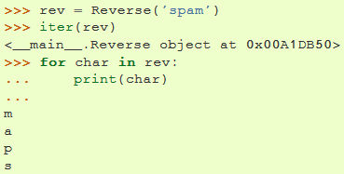
Creating Our Own Iterator
Here is how we can add iteration to our own classes:
We define an __iter__() method which returns an object with a __next__() method
We can implement __next__() inside the class, and simply return self as the iterator

Slide 27


Generators
A generator is a function that returns an iterator
It looks like a normal function except that it uses yield whenever it wants to return data(instead of return)
When next() is called on it (from a for loop), the generator resumes from where it left off
It remembers data values & the last executed statement

Slide 28
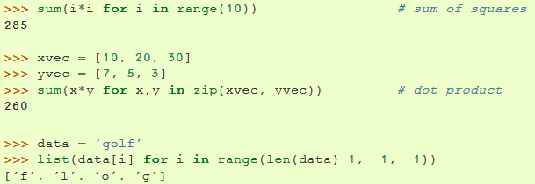

Generators Expressions
We can write short generators expressions
The syntax is similar to list comprehensions
But with ( ) instead of [ ]
The expressions are designed to be used right away by an enclosing function that expects an iterable object

Slide 29

Iterators & Generators Exercises
Write a generator that gets a number n and traverses through all the even numbers between 0-n.
Then use this generator to create a list of all single
digit even numbers.
Write a class iterator called Spiral that traverses a list in a spiral way going from the edges towards the center. If the list has n items, it traverses in the following order: 0, n-1, 1, n-2, …

Slide 30
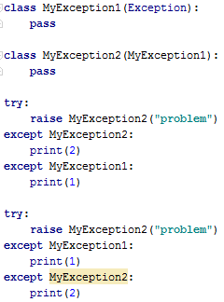
Custom Exception Classes
We can create custom exception classes derived from Exception
We can create a hierarchy of exception classes
except blocks excepts exceptions that are of their type
Including inherited types
But not the opposite

